Slide 1
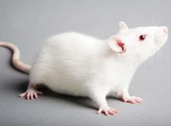
Pain, Distress and Humane Endpoints
Stephanie Cook
Rachel Feldman
Noel Ramsey
Cody Yager
Group 5 “The Fun Table”
ICARE TTI: May 1-4, 2017

Slide 2
Audience – PIs writing protocols for the first time
GOAL
  Understand the concepts of pain, distress, and humane endpoints in animals.
OBJECTIVES
  Identify pain and distress in rodents (USDA and non-USDA).
  Categorize pain and distress levels appropriately.
  Formulate relevant humane endpoints.

Slide 3
Assessment Outline
Pre-assessment (Summative) on pain and distress including humane endpoints. The intent is to find out what the PI knows.
Provide Training (Formative) on pain, distress and humane endpoints.
Post-assessment (Summative) on pain and distress including humane endpoints. The intent is to find out what the PI has learned.

Slide 4
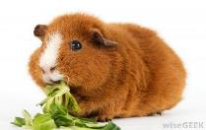
PRE-ASSESSMENT SCENARIO #1
What USDA Pain Category does each example represent?
Single blood collection in Guinea Pigs from the saphenous vein.
Single blood collection in anesthetized Guinea Pigs from the vena cava.
Single blood collection in non-anesthetized Guinea Pigs from the vena cava.
Notes:
FLY THEM IN
Is there a humane endpoint?
Is there a humane endpoint?
Category E

Slide 5
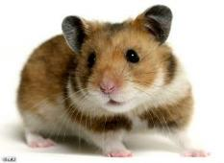
PRE-ASSESSMENT SCENARIO #2
NIH FUNDED WORK:
Hamsters are inoculated with Ebola virus. Survival is expected to be 42 days but animals start to show signs of disease at day 28. Animals become hunched, scruffy, lose 15-20% of their body weight, eventually present with a head tilt, marked lethargy, lack of movement, and inappetance. Fifty percent (50%) mortality is expected by day 42.
At what point should these animals be euthanized due to end stage illness and humane endpoints criteria?

Slide 6
Definitions of Pain and Distress
Pain – physical suffering and discomfort caused by illness or injury. Guide 8th edition.
Distress – an aversive state in which an animal fails to cope or adjust to various stressors with which it is presented. Guide 8th edition.

Slide 7
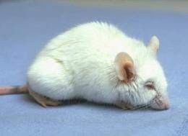
Common Signs of Pain and Distress in Mice
Eyelids partially closed
Changes in respiration
Rough hair coat
Increased vibrissal (whisker) movements
Unusually apprehensive or aggressive
Possible writhing, scratching, biting, self-mutilation
Hunched posture and guarding
Aggressive vocalization when handled or palpated.

Slide 8
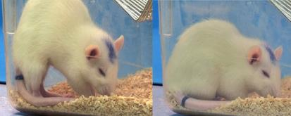
Common Signs of Pain and Distress in Rats
Porphyrin staining around eyes and nose
Rough hair coat, piloerection, and/or hair loss
Increased aggression towards humans and cage mates
Reduced exploration behavior/natural behaviors and lethargy
Aggressive vocalization when handled
Licking, biting and/or scratching
Eyelids partially closed
Guarding

Slide 9
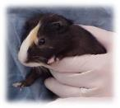
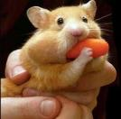
Species-specific Signs of Pain and Distress in Guinea Pigs and Hamsters
Guinea Pigs
Hamsters
  Hunched posture
  Quiet (no squealing)
  Reduced food/water intake
  Weight loss
  Hunched posture
  Decreased activity
  Weight loss
  Piloerection
  Lack of grooming

Slide 10
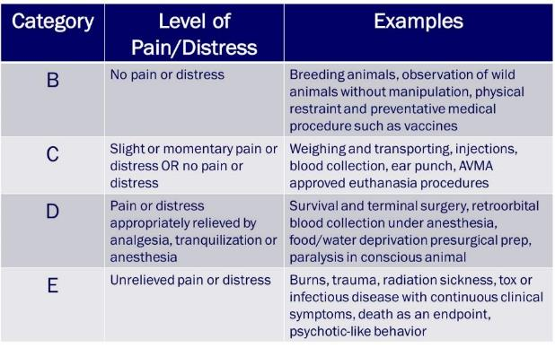
Pain and Distress Categories

Slide 11
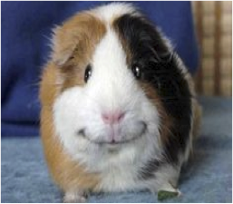
ACTIVE LEARNING
Concept Mapping

Slide 12
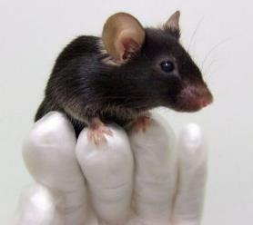
Definition of Humane Endpoints
The earliest scientifically justified point at which pain or distress can be prevented while meeting the scientific aims of the study. (NIH/ARAC)

Slide 13
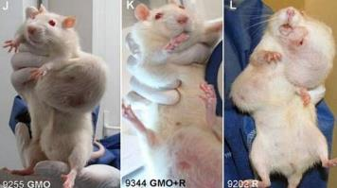
What can be used as a humane endpoint?
Weight loss – Ex. 20%
Won’t or can’t eat/drink: 1 day, 2 days, what’s appropriate to species
Behavioral: Ex. Clinical Scoring sheet
Elevated body temperature
Abnormal neurological movement – twitching, paralysis, inability to stand
Respiratory distress, diarrhea, hunched posture, lethargy
Tumor size
Moribundity

Slide 14
ACTIVE LEARNING
Consensogram
  Drinking
  Half closed eyes
  20% weight loss
  Vocalization
  Writhing
  Self-mutilation
  Nesting behavior
  Moribund

Slide 15
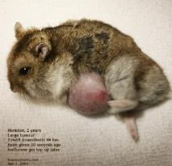
POST-ASSESSMENT SCENARIO #1
Various cancer studies involving tumor growth in hamsters could result in differing Humane Use Category classifications. Ex:
  SC tumor on back, slow growing, doesn’t impact mobility or cause self mutilation.
    Category C
  Breast tumor that may ulcerate if left too long; a larger tumor ulcerates and there is 5% weight loss. What category is applicable -
    If the tumor is treated?
      Category D
    If the tumor is left untreated?
      Category E
Notes:
Behavioral changes, physical changes such as abdominal distension. Lethargy, not eating or drinking and tumor size by radiograph.

Slide 16
POST-ASSESSMENT SCENARIO #1 con’t
  A tumor is injected intracardially and under anesthesia. Tumor is not visible but it is assumed painful. No weight loss is detected, however, the growing tumor is seen by ultrasound.
  If allowed to grow, should humane endpoints need to be determined?
    Yes
  What category would you place these animals into?
    Category E

Slide 17
POST-ASSESSMENT SCENARIO #2
Experimental Autoimmune Encephalomyelitis (EAE) model in mice.
  Mice will be injected with a compound that induces hind limb paralysis that they may or may not recover from. These animals will not experience pain but will experience distress. These animals will only be able to reach food and water when placed on the floor of the cage yet there will be weight loss of 20%. There is a possibility that animals will self-injure.
  Should this model utilize a scoring system to determine humane endpoints?
Notes:
1. Floppy tail
2. Hind limb paralysis (splayed rear and slow to right self)
3. Unilateral hind limb paralysis
4. Bilateral hind limb paralysis.
5. Moribund.

Slide 18
CONCLUSION
OBJECTIVES
Identify pain and distress in rodents (USDA and non-USDA).
Categorize pain and distress levels appropriately.
Formulate relevant humane endpoints.

Slide 19
Special Thanks to Lynn Anderson and Pat Brown for all of your support with this project!
Stephanie, Noel, Rachel and Cody

